Slide 1

Software Architecture
SSE USTC Qing Ding
dingqing@ustc.edu.cn
http://staff.ustc.edu.cn/~dingqing

Slide 2

Quality Attributes of Architecture II
Performance

Slide 3
Agenda
Performance
  Source of stimulus
  Stimulus
  Environment
  Artifact
  Response
  Response measure
  Tactics

Slide 4
PERFORMANCE
Performance is about timing
  Basically performance is concerned with how long it takes the system to respond when an event occurs.
  One of the things that make performance complicated is the number of event sources and arrival patterns.
    Events can arrive from user requests, from other systems, or from within the system.
    An arrival pattern for events may be characterized as either periodic or stochastic. Events can also arrive sporadically.
    Multiple users or other loading factors can be modeled by varying the arrival pattern for events.

Slide 5
PERFORMANCE
Performance is about timing
  The response of the system to a stimulus can be characterized by
    latency (the time between the arrival of the stimulus and the system's response to it)
    deadlines in processing (in the engine controller, for example, the fuel should ignite when the cylinder is in a particular position, thus introducing a processing deadline)
    the throughput of the system (e.g., the number of transactions the system can process in a second)
    the jitter of the response (the variation in latency)
    the number of events not processed because the system was too busy to respond
    the data that was lost because the system was too busy

Slide 6
PERFORMANCE
Source of stimulus.
  The stimuli arrive either from external (possibly multiple) or internal sources.
Stimulus.
  The stimuli are the event arrivals. The arrival pattern can be characterized as periodic, stochastic, or sporadic.
Artifact.
  The artifact is always the system’s services.
Environment.
  The system can be in various operational modes, such as normal, emergency, or overload.

Slide 7
PERFORMANCE
Response.
  The system must process the arriving events. This may cause a change in the system environment (e.g., from normal to overload mode).
Response measure.
  The response measures are the time it takes to process the arriving events (latency or a deadline by which the event must be processed), the variation in this time (jitter), the number of events that can be processed within a particular time interval (throughput), or a characterization of the events that cannot be processed (miss rate, data loss).

Slide 8
PERFORMANCE
Possible Values
One of a number of independent sources, possibly from within system
Periodic events arrive; sporadic events arrive; stochastic events arrive
System
Normal mode; overload mode
Processes stimuli; changes level of service
Latency, deadline, throughput, jitter, miss rate, data loss
Portion of Scenario Source
Stimulus
Artifact
Environment Response
Response Measure

Slide 9
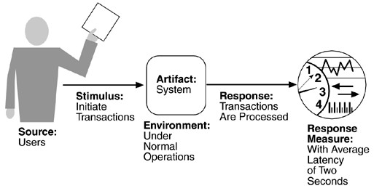
PERFORMANCE

Slide 10

A case of performance optimization
BT –
BitTorrent, in short BT
  Developed by Bram Cohen in 2002
  Bram Cohen entered SNYU in 1993
Bram released BT in 2002, but it was not so attractive at that time
In May, 2003, Bram published a 5-­‐‑page paper on Workshop on Economics of Peer-­‐‑to-­‐‑Peer Systems, 2003
  This paper has been referenced more than several hundred times
  Now, BT and its various modified versions, such as BitComet and BitSpirit have been an important common tool for users.

Slide 11
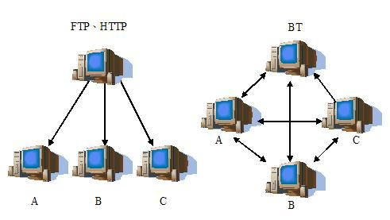
BT
High speed download
10

Slide 12
BT
FTP
  The seed can not be offline until all the clients finish downloading the file
  The cost of bandwidth is unilateral. The upload bandwidth of seed will be the bottleneck
BT
  Once a client accomplishes download the whole seed, it is a new seed. The original seed could be offline then.
  The original seed even can be offline when no new seed generated.
  If the seed divides the file into 10 segments, and sends segments 1-­‐‑3 to A, 4-­‐‑6 to B, and 7-­‐‑ 10 to C, then the seed can switch from online to offline, since A, B and C can download segments from each other.
BT reduces the workload of seeds and prolongs the life of seeds
  If the original seed leaved, and one of A, B, C voluntarily to be a new seed, the file still be downloadable.

Slide 13
BT
The components of BT
  Tracker
    Records the name and network location of all the downloading members
  Torrent
    Records the location of Tracker and the names of all the segments
    A new member needs to obtain a torrent at first and then get the tracker by the information retrieved from torrent.
  Rarest First Policy
    Every member will share the rarest segments to others in order to speed up the download.
    For example, if user A has segments 1, 2, 3, ,user B has segments 2, 4, 5, user C has segments 1, 3, 5, then the rarest segment is 4. If a member wants to share segments with user B, B will prefer to send segment 4 to him.

Slide 14
BT
The components of BT
  Choking Policy
    If a file is very popular, there will be thousands of users want to download it.
    User A is one of the members who are downloading this file. He must receive many request to share segments.
    But his bandwidth is limited. He only can concurrent share segments to 4 other users.
    He has to refuse most of the request. How to refuse?
    Choking policy: unchoke the 4 fastest users who are sharing segments to me.
  Optimistic Unchoking
    For every 30 seconds, BT randomly selects a user and sends data to him.
    To discover the potential fast member.

Slide 15
BT – 性能优化实例
Dissecting BitTorrent：Five Months in a Torrent’s Life
– （1） BT檔案往往會有flash crowd情形：分享開始的前幾天會湧入大 量人潮，然而高潮退去後人也散得快。
– （2） 下載的速度呈現「多數人下載慢，極少數人下載速度超快」的 情形；不過即使「多數人下載慢」，下載的平均速度仍然比ftp快上不 少。根據實驗，平均下載速度是240K，90%的人速度不會超過520K。 有極少數的人下載速度會達到每秒3000K以上。
– （3） 檔案的存活天數難以從檔案分享十天後的狀況來預測：紐西蘭 學生嘗試著去預測檔案存活天數，不過失敗了。後面我們會看到另外 一篇paper是如何成功預測的。

Slide 16
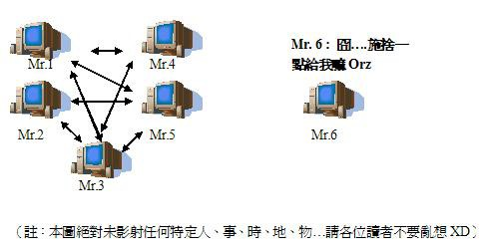
BT
Modeling and Performance Analysis of BitTorrent-­‐‑Like Peer-­‐‑to-­‐‑Peer Networks
  Dongyu Qiu and R. Sirkant, UIUC
  In 2004, SIGCOMM
  Fluid Model
  Free Riding

Slide 17
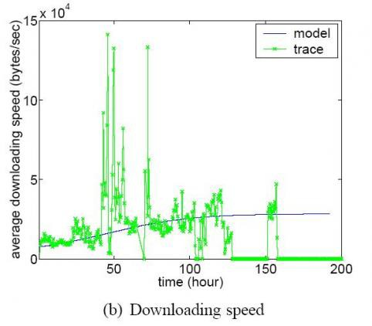
BT
Measurements, Analysis, and Modeling of BitTorrent-­‐‑like Systems.
– The fastest speed of downloading: 50 hours after releasing of file

Slide 18
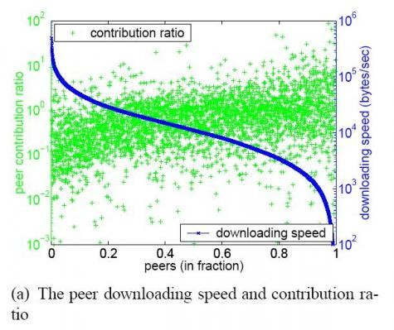
BT
Measurements, Analysis, and Modeling of BitTorrent-­‐‑like Systems.
– A flaw of BT: speed of downloading doesn’t reflect the difference among speed of uploading

Slide 19
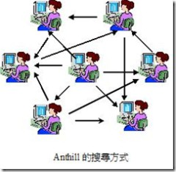
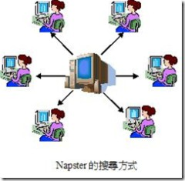
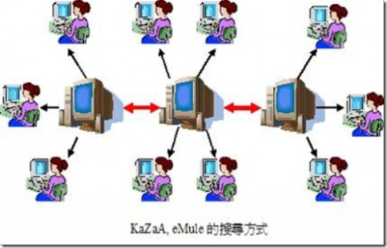
BT
Why don’t BT provide searching?

Slide 20
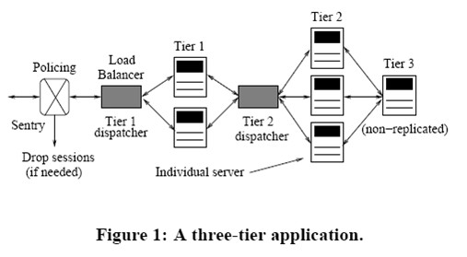
Performance Analysis
An Analytical Model for Multi-­‐‑Tier Internet Services and its Applications
– Bhuvan Urgaonkar, Giovanni Pacificiy, Prashant Shenoy, Mike Spreitzery, and Asser Tantawiy

Slide 21
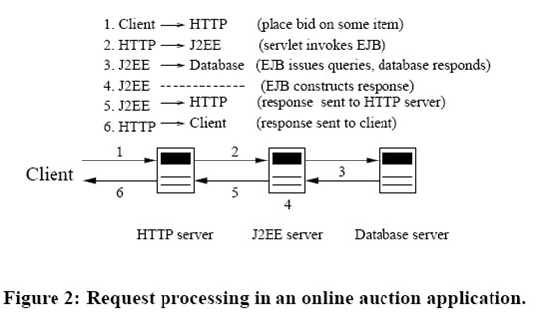
Performance Analysis
An Analytical Model for Multi-­‐‑Tier Internet Services and its Applications
– Bhuvan Urgaonkar, Giovanni Pacificiy, Prashant Shenoy, Mike Spreitzery, and Asser Tantawiy
20

Slide 22
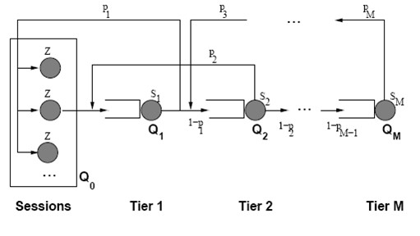
Performance Analysis
An Analytical Model for Multi-­‐‑Tier Internet Services and its Applications
– Bhuvan Urgaonkar, Giovanni Pacificiy, Prashant Shenoy, Mike Spreitzery, and Asser Tantawiy

Slide 23
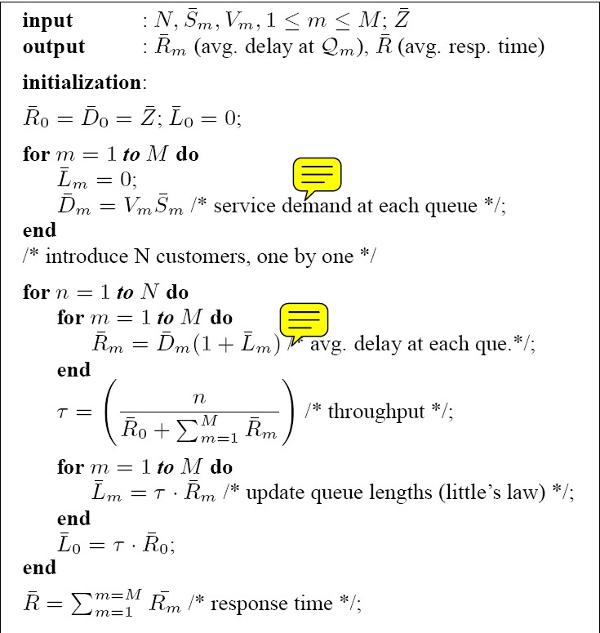
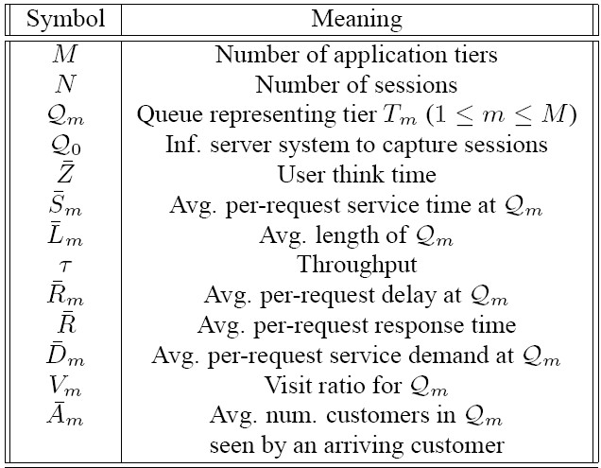
Performance Analysis

Slide 24
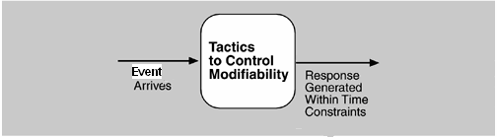
Performance Tactics
The goal of performance tactics is to generate a response to an event arriving at the system within some time constraint.
The event can be single or a stream and is the trigger for a request to perform computation.
It can be the arrival of a message, the expiration of a time interval, the detection of a significant change of state in the system's environment, and so forth.
The system processes the events and generates a response. Performance tactics control the time within which a response is generated.
Latency is the time between the arrival of an event and the generation of a response to it.
Goal of performance tactics

Slide 25
Performance Tactics
After an event arrives, either the system is processing on that event or the processing is blocked for some reason.
This leads to the two basic contributors to the response time: resource consumption. and blocked time
Resource consumption.
  Resources include CPU, data stores, network communication bandwidth, and memory, but it can also include entities defined by the particular system under design.
  Events can be of varying types (as just enumerated), and each type goes through a processing sequence.

Slide 26
Performance Tactics
Blocked time.
  A computation can be blocked from using a resource because of contention for it, because the resource is unavailable, or because the computation depends on the result of other computations that are not yet available.
    Contention for resources.
    Availability of resources.
    Dependency on other computation.
With this background, we turn to our three tactic categories: resource demand, resource management, and resource arbitration.

Slide 27
Performance Tactics-­resource demand
Event streams are the source of resource demand.
  Two characteristics of demand are the time between events in a resource stream (how often a request is made in a stream) and how much of a resource is consumed by each request.
One tactic for reducing latency is to reduce the resources required for processing an event stream. Ways to do this include the following.
  Increase computational efficiency.
  Reduce computational overhead.
Another tactic for reducing latency is to reduce the number of events processed. This can be done in one of two fashions.
  Manage event rate
  Control frequency of sampling.

Slide 28
Performance Tactics-­resource demand
Other tactics for reducing or managing demand involve controlling the use of resources.
  Bound execution times. Place a limit on how much execution time is used to respond to an event. Sometimes this makes sense and sometimes it does not. For iterative, data-­‐‑dependent algorithms, limiting the number of iterations is a method for bounding execution times.
  Bound queue sizes. This controls the maximum number of queued arrivals and consequently the resources used to process the arrivals.

Slide 29
Performance Tactics-­resource management
Even though the demand for resources may not be controllable, the management of these resources affects response times.
Some resource management tactics are:
  Introduce concurrency.
  Maintain multiple copies of either data or computations.
  Increase available resources.

Slide 30
Performance Tactics-­resource arbitration
Whenever there is contention for a resource, the resource must be scheduled. Processors are scheduled, buffers are scheduled, and networks are scheduled.
The architect's goal is to understand the characteristics of each resource's use and choose the scheduling strategy that is compatible with it.
A scheduling policy conceptually has two parts: a priority assignment and dispatching.
– Competing criteria for scheduling include optimal resource usage, request importance, minimizing the number of resources used, minimizing latency, maximizing throughput, preventing starvation to ensure fairness, and so forth. The architect needs to be aware of these possibly conflicting criteria and the effect that the chosen tactic has on meeting them.

Slide 31
Performance Tactics-­resource arbitration
A high-­‐‑priority event stream can be dispatched only if the resource to which it is being assigned is available. Sometimes this depends on pre-­‐‑empting the current user of the resource.
  Possible preemption options are as follows: can occur anytime; can occur only at specific pre-­‐‑emption points; and executing processes cannot be pre-­‐‑empted.
Some common scheduling policies are:
First-­‐‑in/First-­‐‑out.
  FIFO queues treat all requests for resources as equals and satisfy them in turn.
  One possibility with a FIFO queue is that one request will be stuck behind another one that takes a long time to generate a response.
  As long as all of the requests are truly equal, this is not a problem, but if some requests are of higher priority than others, it is problematic.
30

Slide 32
Performance Tactics-­resource arbitration
Fixed-­‐‑priority scheduling.
  Fixed-­‐‑priority scheduling assigns each source of resource requests a particular priority and assigns the resources in that priority order.
  This strategy insures better service for higher-­‐‑priority requests but admits the possibility of a low-­‐‑priority, but important, request taking an arbitrarily long time to be serviced because it is stuck behind a series of higher-­‐‑priority requests.
  Three common prioritization strategies are
    semantic importance
    deadline monotonic.
    rate monotonic.

Slide 33
Performance Tactics-­resource arbitration
Dynamic priority scheduling:
  round robin. Round robin is a scheduling strategy that orders the requests and then, at every assignment possibility, assigns the resource to the next request in that order. A special form of round robin is a cyclic executive where assignment possibilities are at fixed time intervals.
  earliest deadline first. Earliest deadline first assigns priorities based on the pending requests with the earliest deadline.
Static scheduling. A cyclic executive schedule is a scheduling strategy where the pre-­‐‑emption points and the sequence of assignment to the resource are determined offline.

Slide 34
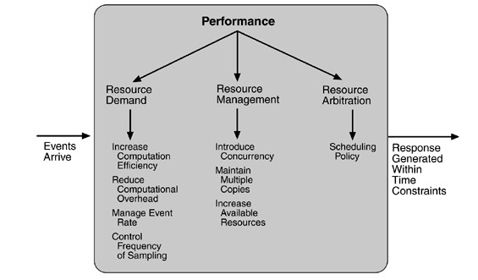
Performance Tactics-­Summary

Slide 35
Project
Suppose you needs to improve the performance of your SNS website. Please describe your design from the following aspects:
  If your SNS website is deployed into a cluster, what tactics would you want to adopt to improve utilization of computing resource?
  What tactics do you think is suitable for your SNS website to reduce the resource contention?
  According to the functions your designed for your SNS website, please give your scheduling policy for resource arbitration.

